Slide 1

Hyperparameter tuning
Tuning process
deeplearning.ai

Slide 2
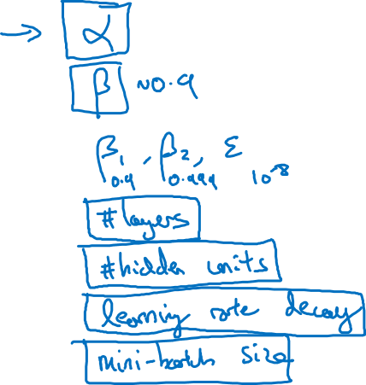
Hyperparameters
Notes:
Learning Rate (Alpha)
Mini Batch Size
Momentum
Hidden Units
No. of Layers
Learning Rate Decay

Slide 3
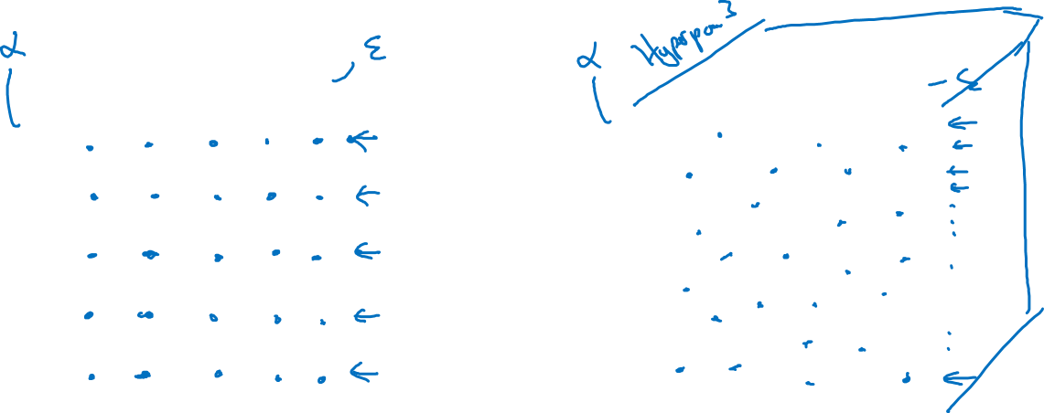
Try random values: Don’t use a grid
Hyperparameter 2
Hyperparameter 2
Hyperparameter 1
Hyperparameter 1

Slide 4
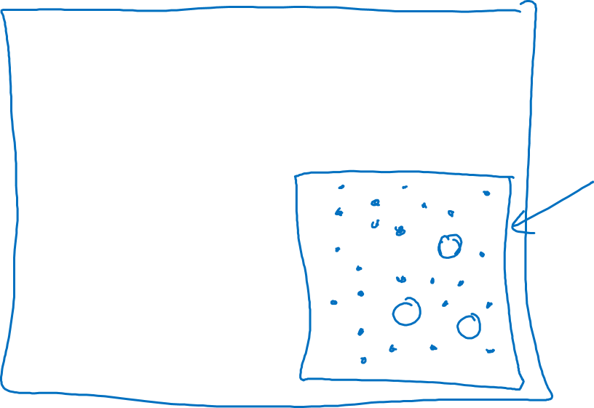
Coarse to fine
Hyperparameter 2
Hyperparameter 1

